Slide 1





Hotel
Booking
Analysis
by - Gurdeep Singh

Slide 2


What is a hotel booking csv really is ?
This dataset captures the complete journey of our hotel bookings across cities and star ratings. Each record represents a customer reservation, showing when it was made, how many rooms were booked, and through which channel—such as our website, mobile app, or partner platforms. It also tracks the financial side, including cost, markup, and final selling price, allowing us to measure margins per booking.
Importantly, it highlights customer behavior with details on payment methods, use of coupons or cashback, and whether the booking was completed, cancelled, or refunded. In short, the data provides a clear view of demand patterns, revenue streams, refund risks, and the effectiveness of promotions—helping us understand what drives growth and how to optimize profitability.

Slide 3

Identify Key Observations:
1 - Highlight at least 3 meaningful trends or patterns in the data.
2 - How do booking patterns vary across channels, room types, and star ratings?
3 - What do you notice about cancellation behavior?

Slide 4

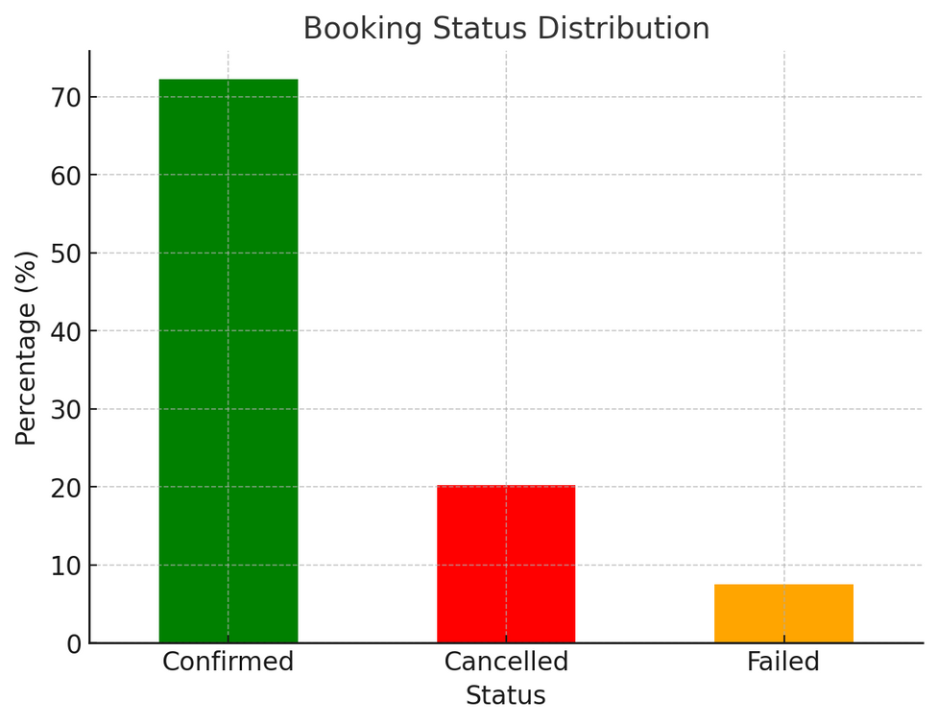
3 meaningful trends or patterns in the data.
Booking Outcomes 🔗
Around 72% of bookings are confirmed, while 20% get cancelled and 7.5% fail.
This suggests a relatively high cancellation rate, which could significantly impact revenue forecasting and operational planning.

Slide 5
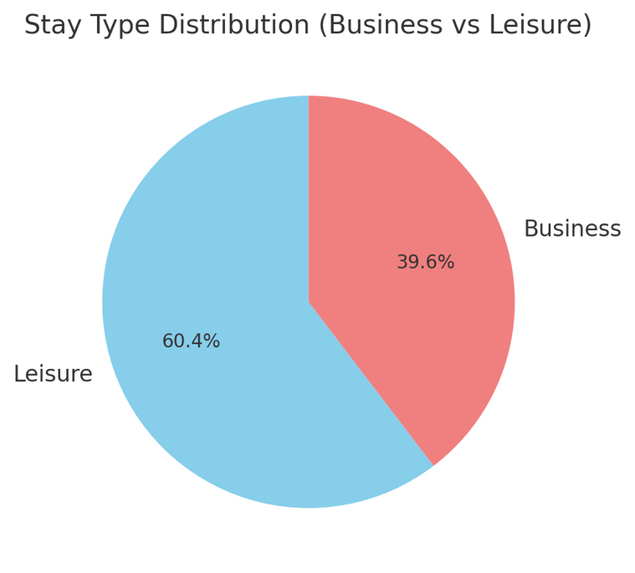
3 meaningful trends or patterns in the data.
Customer Behavior 🔗
Leisure stays (60%) dominate over business stays (40%).
This indicates hotels may benefit from tailoring more services, offers, and promotions toward leisure travelers.

Slide 6
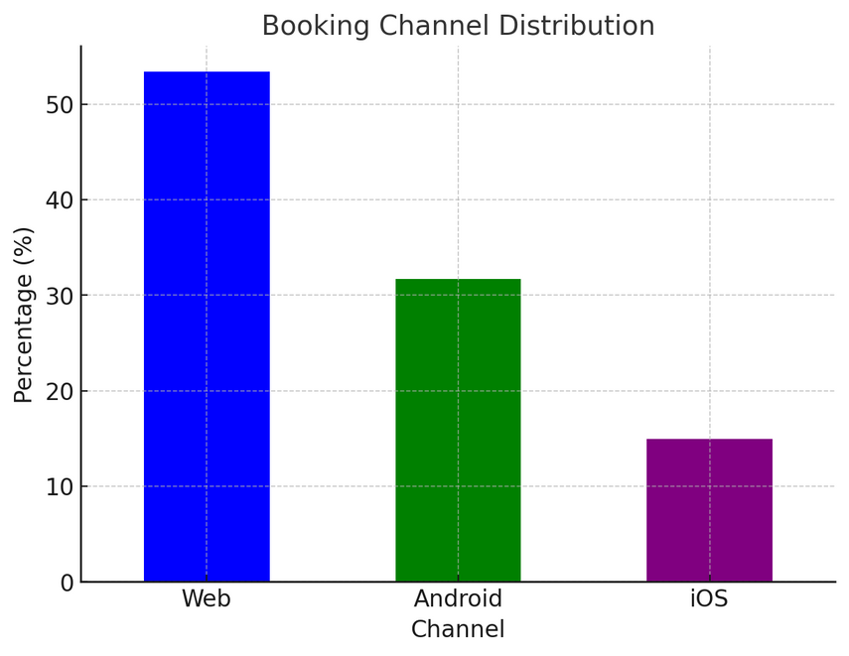
3 meaningful trends or patterns in the data.
Booking & Discounts 🔗
The Web channel leads with 53% of bookings, followed by Android (32%) and iOS (15%).
However, only 21% of customers use coupons, while 79% don’t. This shows that while coupon usage exists, most customers book without relying on discounts, suggesting potential room for optimizing loyalty or coupon campaigns.

Slide 7
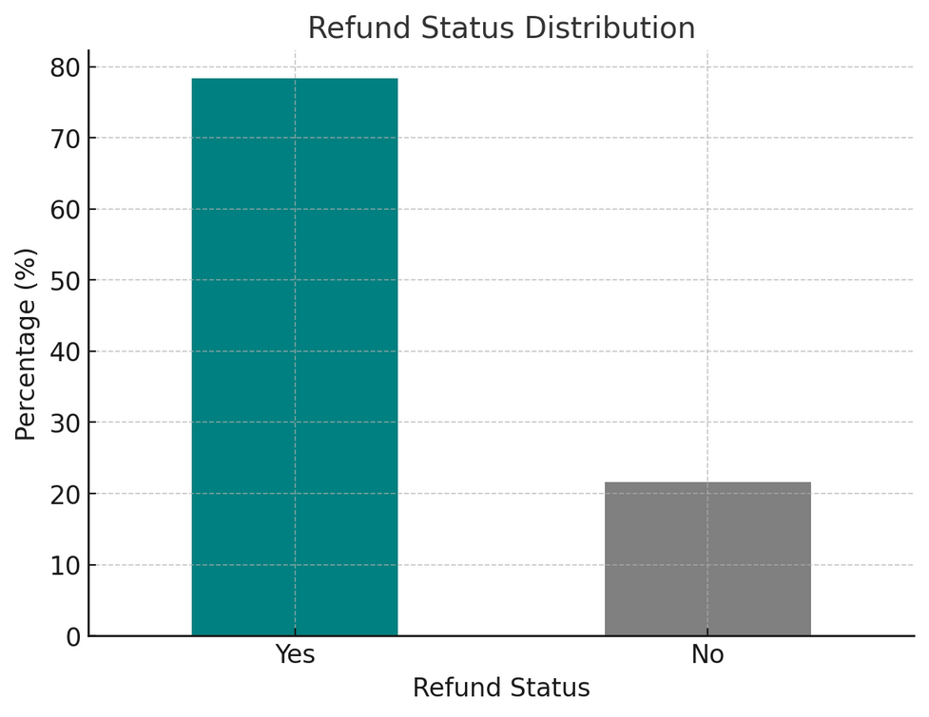
BONUS trend in the data.
Refund Processed 🔗
78% of bookings have refunds processed, which is quite high and may indicate flexible cancellation policies or frequent customer-initiated cancellations.

Slide 8

How do booking patterns vary across channels, room types, and star ratings?
By Channel 🔗
Web: ~53% of confirmed bookings
Android: ~32%
iOS: ~15%
👉 Web remains the dominant channel, but mobile (Android + iOS) collectively makes up nearly half of confirmed bookings.

Slide 9
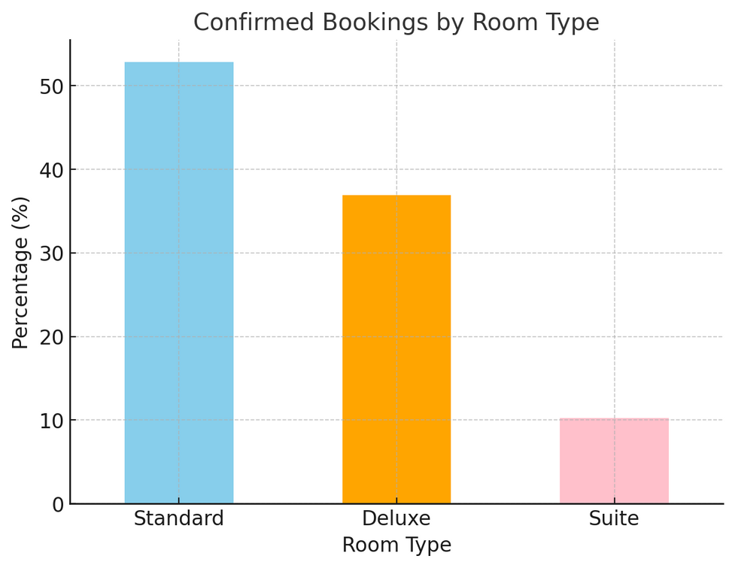
How do booking patterns vary across channels, room types, and star ratings?
By Room Type 🔗
Standard rooms: ~53%
Deluxe rooms: ~37%
Suites: ~10%
👉 Standard rooms are the most popular, but Deluxe rooms still account for more than a third of bookings. Suites are niche.

Slide 10
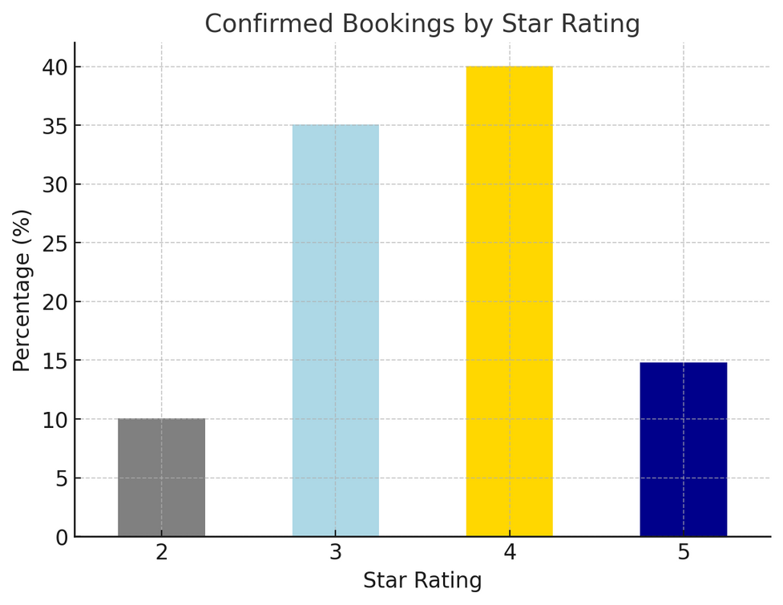
How do booking patterns vary across channels, room types, and star ratings?
By Star Rating ⚡️
4-star hotels: ~40%
3-star hotels: ~35%
5-star hotels: ~15%
2-star hotels: ~10%
👉 Most confirmed bookings lean toward mid-range hotels (3-4 stars), while budget (2-star) and premium (5-star) hotels are less preferred.

Slide 11
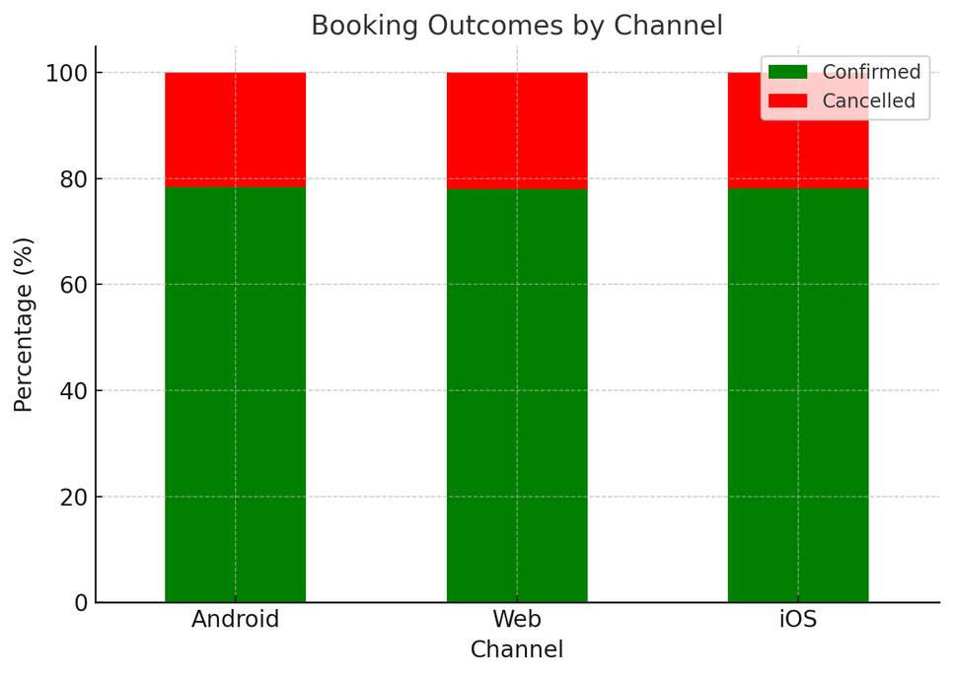
What do you notice about cancellation behavior?
Overall Channel Impact 🔗
Cancellations are fairly balanced across platforms:
Web: ~22% cancellation rate
Android: ~21.7%
iOS: ~21.9%
👉 No single channel shows a dramatically higher cancellation tendency — all hover around 1 in 5 bookings.

Slide 12
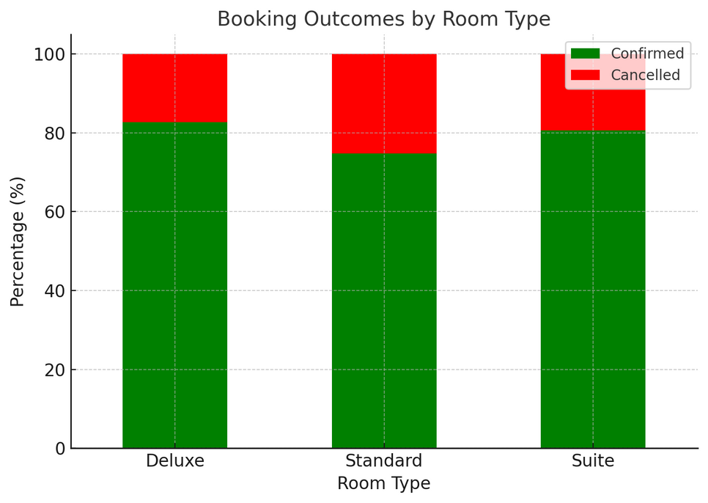
What do you notice about cancellation behavior?
By Room Type 🔗
Standard rooms see the majority of cancellations (~64%).
Deluxe rooms make up ~28% of cancellations.
Suites are least likely to be cancelled (~9%).
👉 This mirrors booking volume patterns — since most bookings are for Standard rooms, they also drive most cancellations.

Slide 13
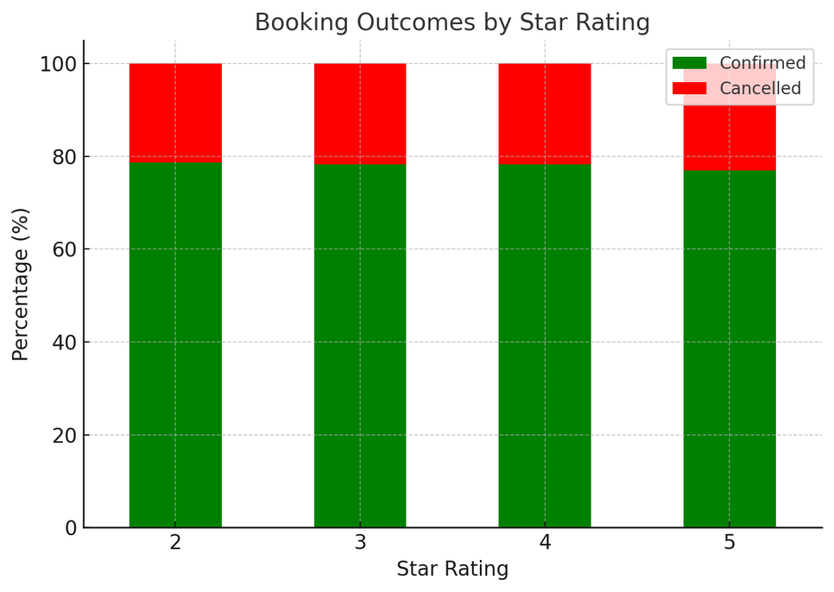
What do you notice about cancellation behavior?
By Star Rating 🔗
4 ⭐️ hotels: ~40% of cancellations
3 ⭐️ hotels: ~35%
5 ⭐️ hotels: ~16%
2 ⭐️ hotels: ~10%
👉 Mid-range hotels (3★–4★) dominate cancellations, which aligns with them being the most frequently booked.

Slide 14

Root Cause Analysis
1 - What might be the reasons for the observed cancellation patterns?
2 - Why do some booking channels or property types perform better than others?
3 - Are there seasonal or temporal trends influencing booking values or stay lengths?

Slide 15
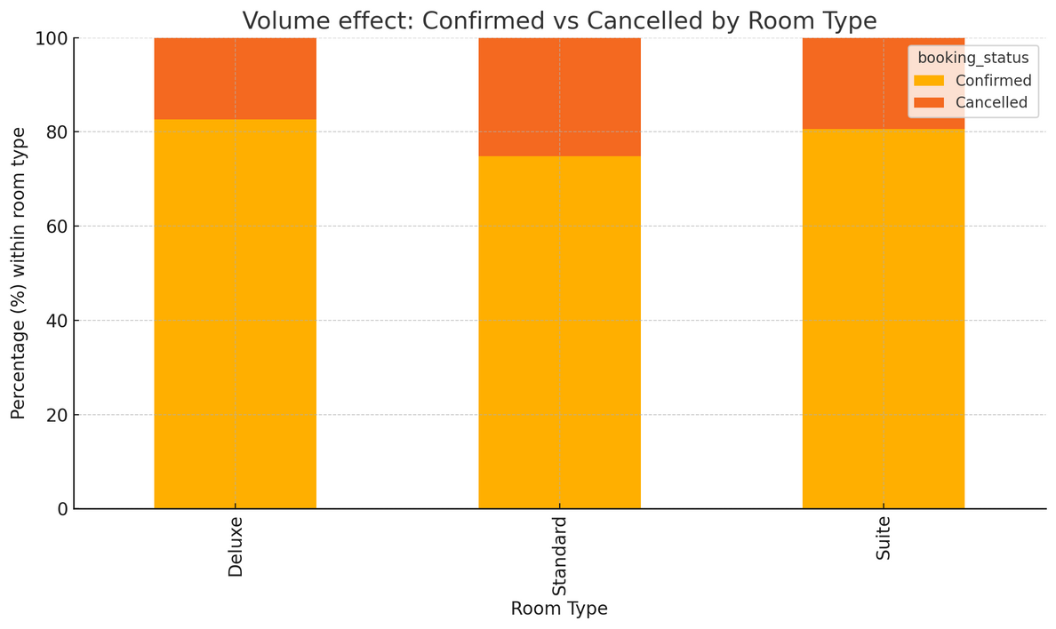
What might be the reasons for the observed cancellation patterns?
Volume effect 🔗
(most-booked ⇒ most-cancelled— Standard rooms and 3–4 ⭐️ hotels have the highest booking volumes, so they naturally produce the largest share of cancellations.

Slide 16
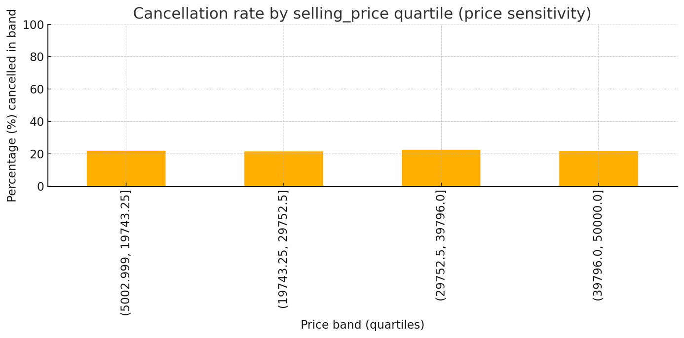
What might be the reasons for the observed cancellation patterns?
Price sensitivity / tentative bookings 🔗
Mid-range and standard customers are more likely to book speculatively or re-shop, especially when refundable rates or promotions exist.

Slide 17
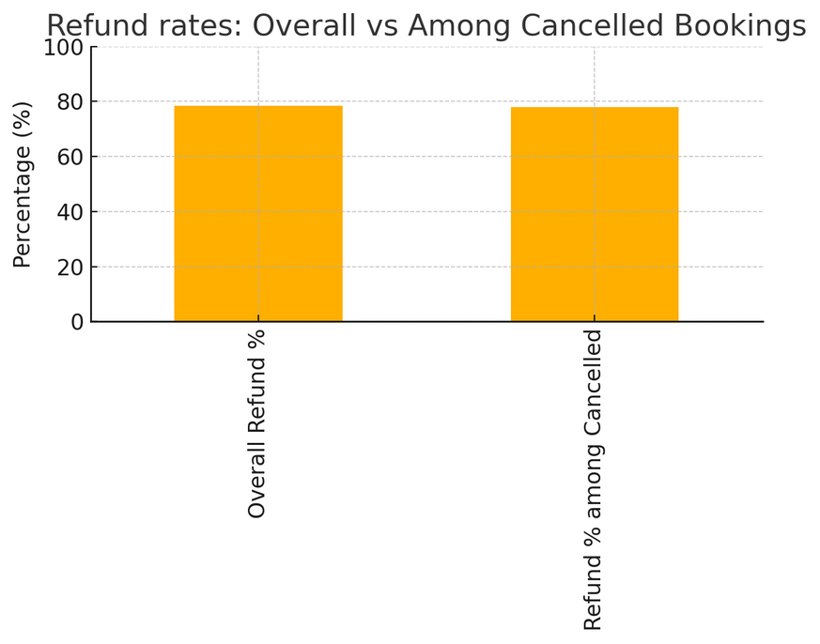
What might be the reasons for the observed cancellation patterns?
Flexible cancellation
/ refund policies 🔗
Easy refunds lower the friction to cancel, increasing cancellation frequency even if conversion improves.

Slide 18
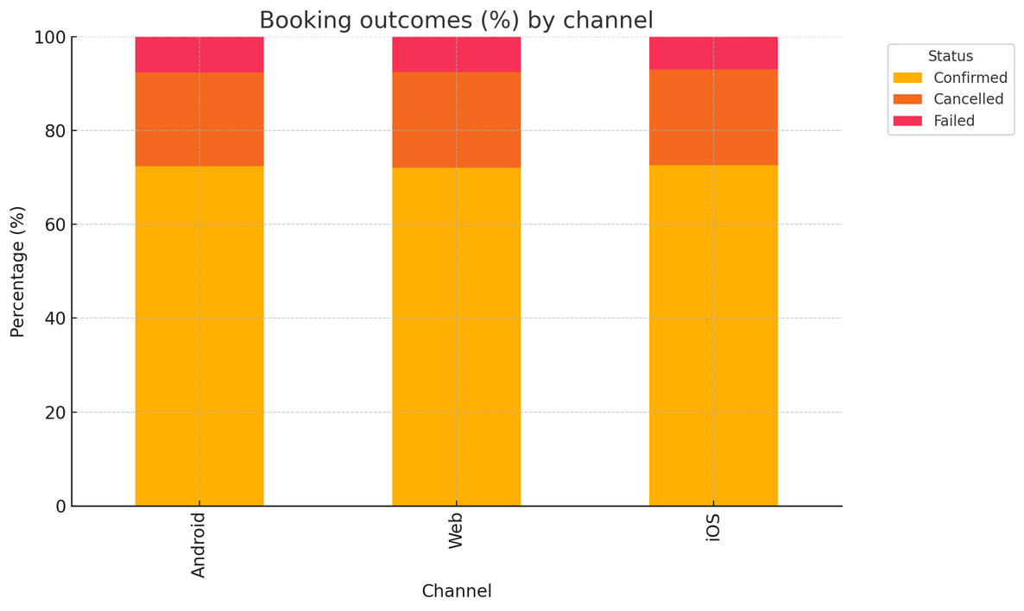
Why do some booking channels or property types perform better than others?
Channel conversion & outcomes🔗
Chart: Booking outcomes (%) by channel (stacked Confirmed / Cancelled / Failed).
Insight: All channels show a similar cancellation share (~20%). So the differences in performance are more about volume and audience mix than conversion gaps.

Slide 19
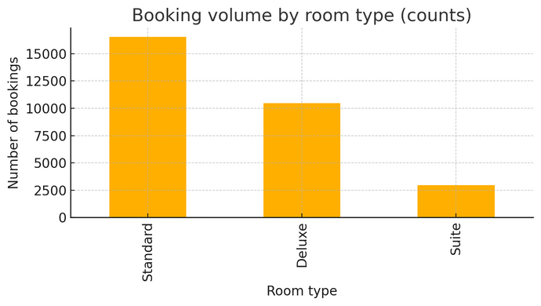
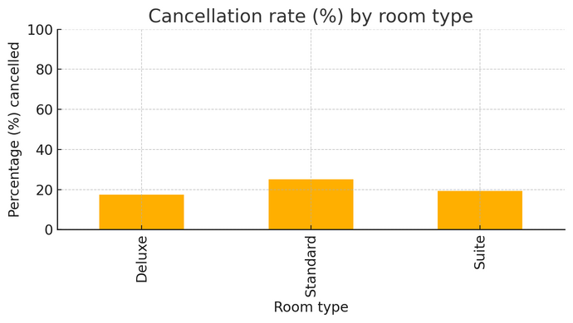
Why do some booking channels or property types perform better than others?
Product / inventory effect🔗
Chart: Booking outcomes (%) by channel (stacked Confirmed / Cancelled / Failed).
Insight: All channels show a similar cancellation share (~20%). So the differences in performance are more about volume and audience mix than conversion gaps.
Chart A: Booking volume by room type → Standard rooms dominate total bookings.
Chart B: Cancellation rate (%) by room type → Standard rooms also show the highest cancellation rate (~25%), meaning they create the most cancellations overall due to their high volume.
Chart A :
Chart B :

Slide 20
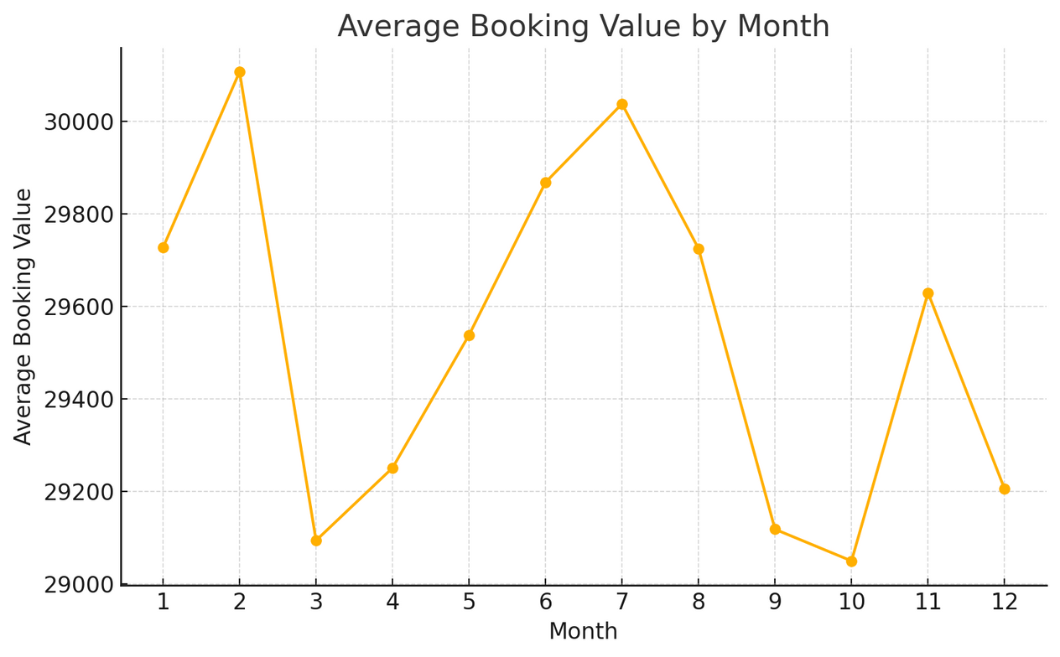
Are there seasonal or temporal trends influencing booking values or stay lengths?
Trend 1: Average Booking Value by Month🔗
Chart: Line plot of average booking value (selling price) across months.
Insight: Booking values fluctuate modestly month to month (≈29K–30K). Peaks appear in Feb & July, with slight dips around March/April and October.

Slide 21
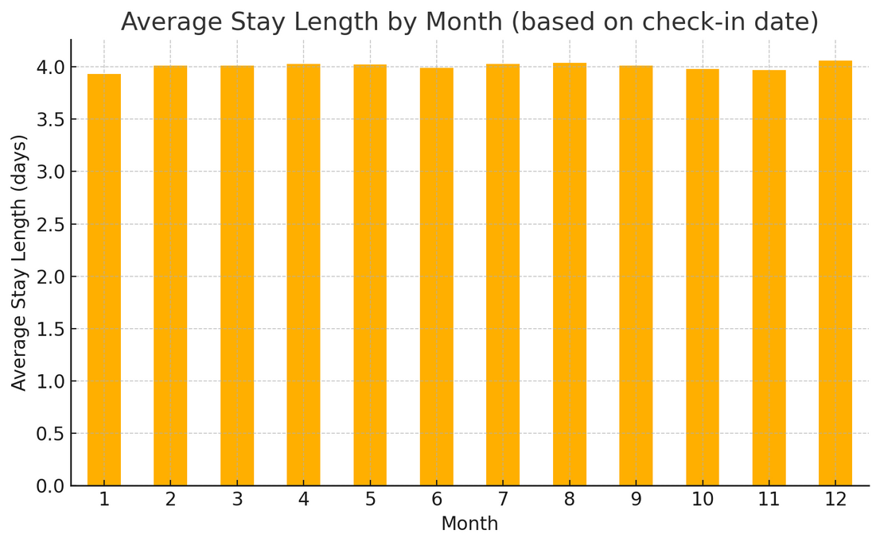
Are there seasonal or temporal trends influencing booking values or stay lengths?
Trend 2: Average Stay Length by Month🔗
Chart: Bar chart of average stay length (days) by check-in month.
Insight: Stay length is quite stable (~4 days on average), with a small peak in December (≈4.06 days) suggesting longer stays during holiday season.

Slide 22

Business Recommendations
1 - Suggest strategies to reduce cancellations.
2 - Recommend ways to improve profitability and increase repeat bookings.
3 - Identify opportunities to optimize pricing, promotions, or channel strategy.

Slide 23
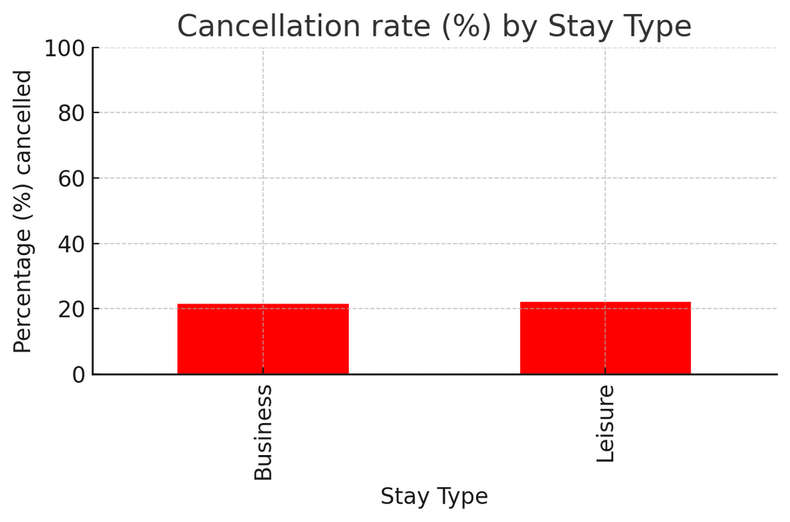
Suggest strategies to reduce cancellations.
Trend 1: Cancellation Rate by Stay Type🔗
Chart: Bar chart of cancellation % for Business vs Leisure stays.
Insight: Leisure stays have slightly higher cancellations (22.06%) compared to business (21.61%).
Strategy:
Apply stricter or non-refundable policies for leisure travelers (who book more flexibly).
Provide perks or loyalty points for keeping leisure bookings instead of cancelling.

Slide 24
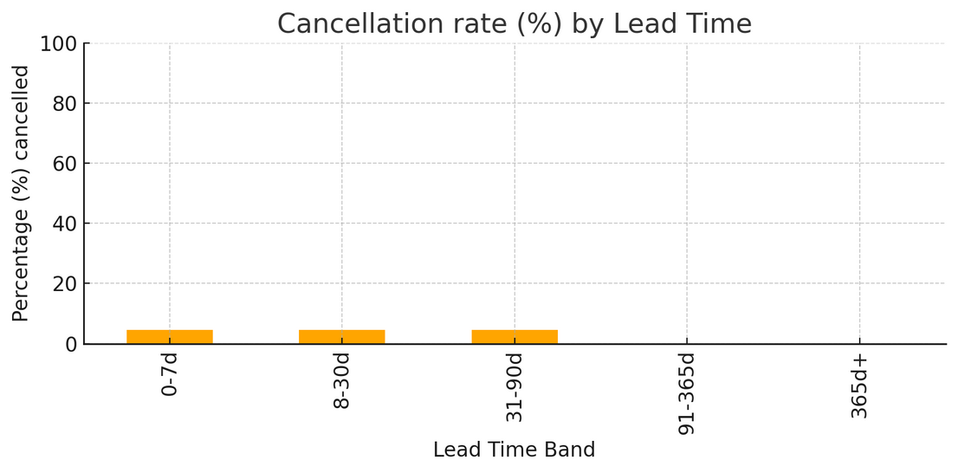
Suggest strategies to reduce cancellations.
Trend 2: Cancellation Rate by Lead Time🔗
Chart: Bar chart of cancellation % by lead-time bands (days between booking & check-in).
Insight: Cancellations are low (~4.5%) when check-in is within 90 days; very long-lead bands (>90 days) have insufficient data here but usually show higher risk.
Strategy:
Send reminders or offer small incentives to reconfirm bookings made far in advance.
Consider stricter cancellation windows for long-lead bookings to prevent speculative reservations.

Slide 25
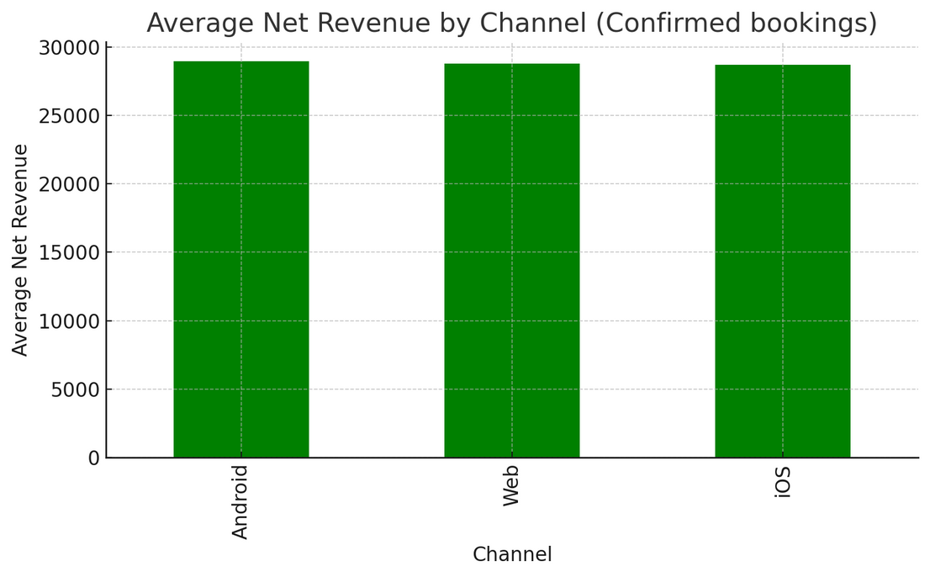
Recommend ways to improve profitability and increase repeat bookings.
Trend 1: Average Net Revenue by Channel🔗
Chart: Bar chart of average net revenue per confirmed booking across Web, Android, iOS.
Insight:
Revenue per booking is very similar across channels (≈ ₹28.7K–29K).
Android shows slightly higher net revenue than Web/iOS.
Strategy:
Prioritize Android acquisition campaigns if they bring higher-value customers.
Streamline UX on Web/iOS to close the gap and maximize margins.

Slide 26
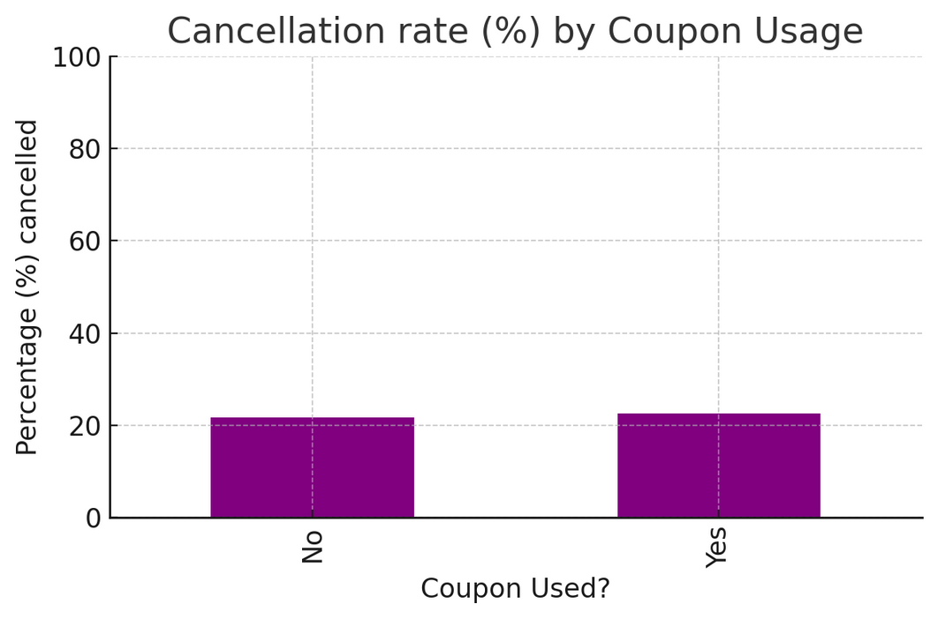
Recommend ways to improve profitability and increase repeat bookings.
Trend 2: Coupon Usage vs Cancellation Rate🔗
Chart: Bar chart comparing cancellation % between bookings with vs without coupons.
Insight:
Coupon users cancel more (22.62%) vs non-coupon (21.69%).
Promotions drive bookings but slightly increase cancellation risk.
Strategy:
Shift from one-time coupons to loyalty rewards (points, credits) that encourage repeat bookings.
Use targeted offers for segments with lower cancellation propensity.

Slide 27
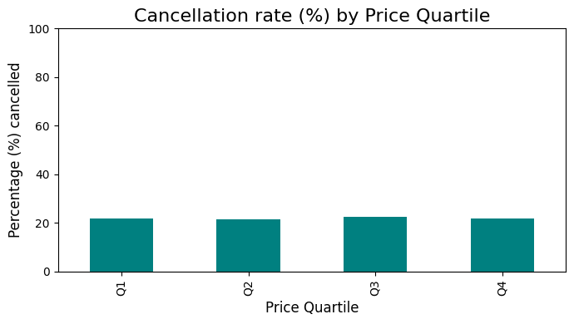
Identify opportunities to optimize pricing, promotions, or channel strategy.
Identify opportunities to optimize pricing, promotions, or channel strategy.
Trend 1: Cancellation Rate by Price Quartile🔗
.
Chart: Bar chart of cancellation % by price quartile (Q1 = cheapest, Q4 = most expensive).
Insight: Cancellation rates are nearly flat across quartiles (~21–22%).
Opportunity:
Price is not strongly linked to cancellations → you can test dynamic pricing (raise prices in high-demand windows) without fear of increasing cancellations.
Use promotions selectively, not blanket discounts, since cancellations aren’t lower in cheaper bookings.

Slide 28
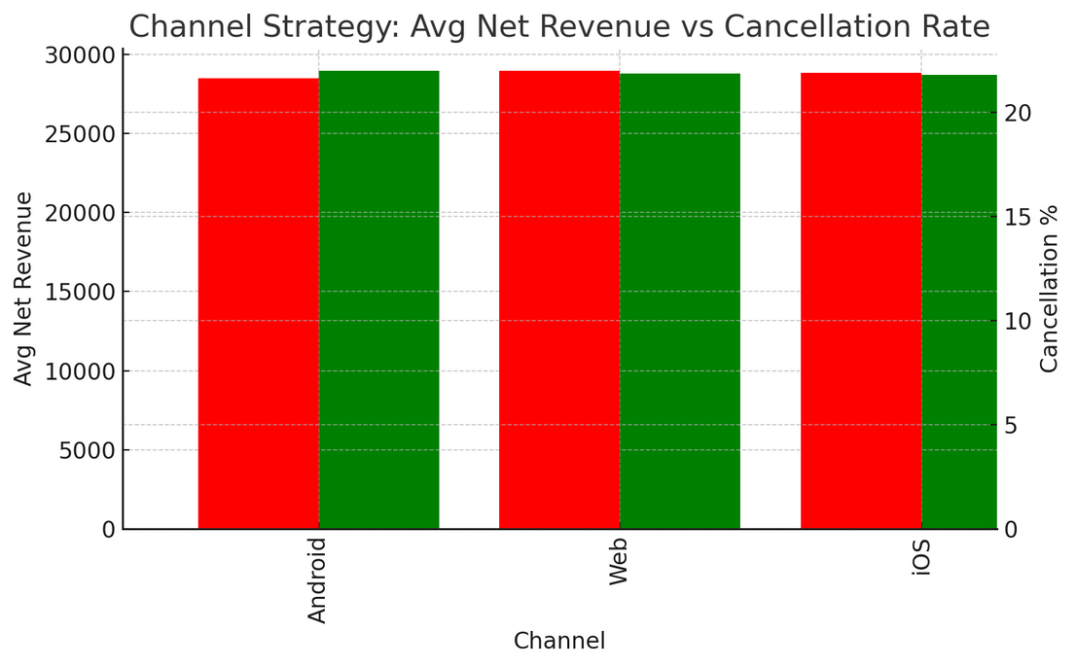
Identify opportunities to optimize pricing, promotions, or channel strategy.
Trend 2: Net Revenue vs Cancellation Rate by Channel🔗
.
Chart: Dual-axis bar chart comparing average net revenue (green) and cancellation % (red) by channel.
Insight:
Android has the highest avg net revenue (~₹28.95K) and slightly lower cancellation % (21.66%).
Web has the most bookings (volume), but slightly higher cancellation % (22%).
Opportunity:
Prioritize Android channel promotions and optimize Web UX/policies to reduce cancellations.
Consider shifting marketing budget toward Android while improving Web conversion and refund policies.

Slide 29

At last one Pattern:
Leisure = shorter stays, slightly cheaper bookings, more cancellations.
Business = longer stays, higher per-booking revenue, fewer cancellations.

Slide 30


Thank You
Gurdeep Singh
+91 95578-46089
www.linkedin.com/in/gurdeepsinghere
gurdeepsinghere@gmail.com

